Slide 1


Slide 2

Microsoft Azure
Francesco Scullino

Slide 3
Agenda:
ISMB
Microsoft Innovation Center Torino
Microsoft Azure Overview

Slide 4

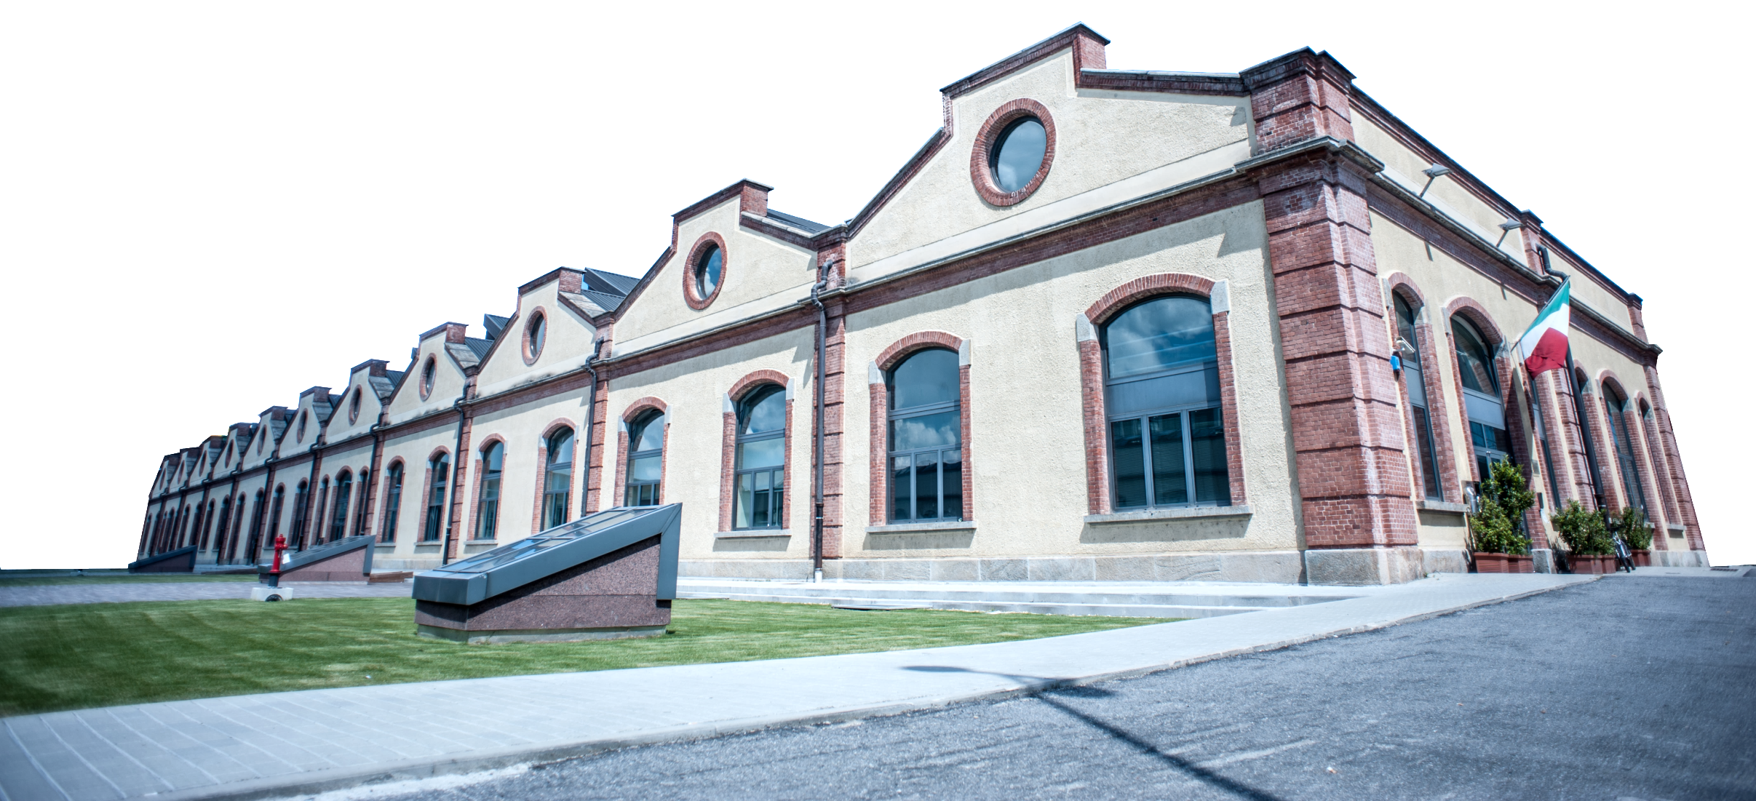


IX
Founded by Compagnia di San Paolo and Politecnico di Torino in 2000, ISMB is a non-profit Research & Innovation Center on ICT.
Our mission is creating value-driven and socially relevant technological & process innovations in close collaboration with industry and institutions
www.ismb.it
Notes:
Aggiornare I loghi in alta risoluzione

Slide 5





PEOPLE & NETWORK
SOCIETY
ENTERPRISES
Cooperatives
Foundations
Third Sectors
Industries
Smes
SMES IN PARTNERSHIP PROGRAM
MEDIA
THIRD SECTOR
INDUSTRIES
SUPPLIERS
We are more than 130 researchers working on R&D projects.
Our domain is the ICT and the innovation technology.
YOUNG TALENTS
RESEARCHERS
ORDINARY MEMBERS
INDUSTRIES CONFEDERATION
AFFILIATED RESEARCH INSTITUTIONS
CITY OF TURIN
103 Under 36
STUDENTS
CHAMBER OF COMMERCE
75 Employees
52 Collaborators
ITALIAN UNIVERSITIES
CENTRAL GOVERNMENT
95% Graduates
EUROPEAN COMMISSION
LOCAL GOVERNMENT
87% Engineers
WORLWIDE RESEARCH CENTERS
ESA & ASI
33% PhD
RESEARCH
Universities,
Research Centres
ISTITUTIONS
PA, Local Gov
European Commission

Slide 6
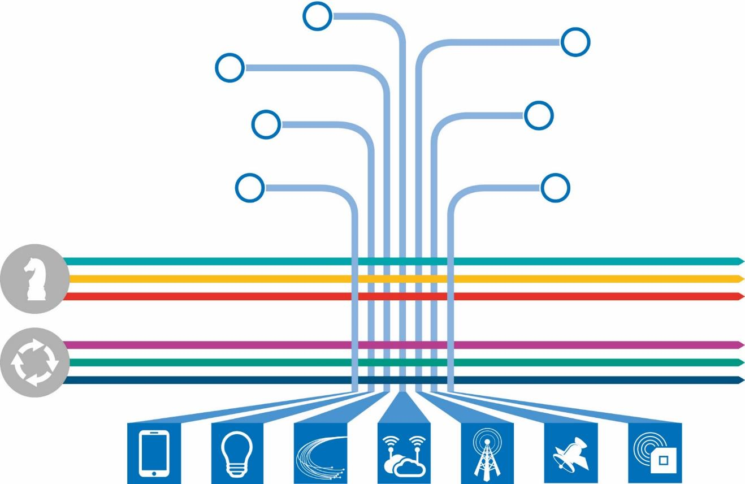
ISMB STRUCTURE
ADVANCED COMPUTING & ELECTROMAGNETICS
MULTI-LAYER WIRELESS SOLUTIONS
ISMB counts more than 140 researchers working on R&D projects. More that half of the workforce is under 35, 85% are engineers and 36% has a PhD.
APPLIED PHOTONICS
INNOVATION DEVELOPMENT
NAVIGATION TECHNOLOGIES
MOBILE SOLUTIONS
PERVASIVE TECHNOLOGIES
7 RESEARCH AREA
SMART CITY
3 STRATEGIC PROGRAMS
SMART ENERGY
SMART HEALTH
EMERGING TRENDS & OPPORTUNITIES
3 FUNCTIONS
HIGHER & PROFESSIONAL EDUCATION
FRONT-END, MARKETING & COMMUNICATIONS

Slide 7

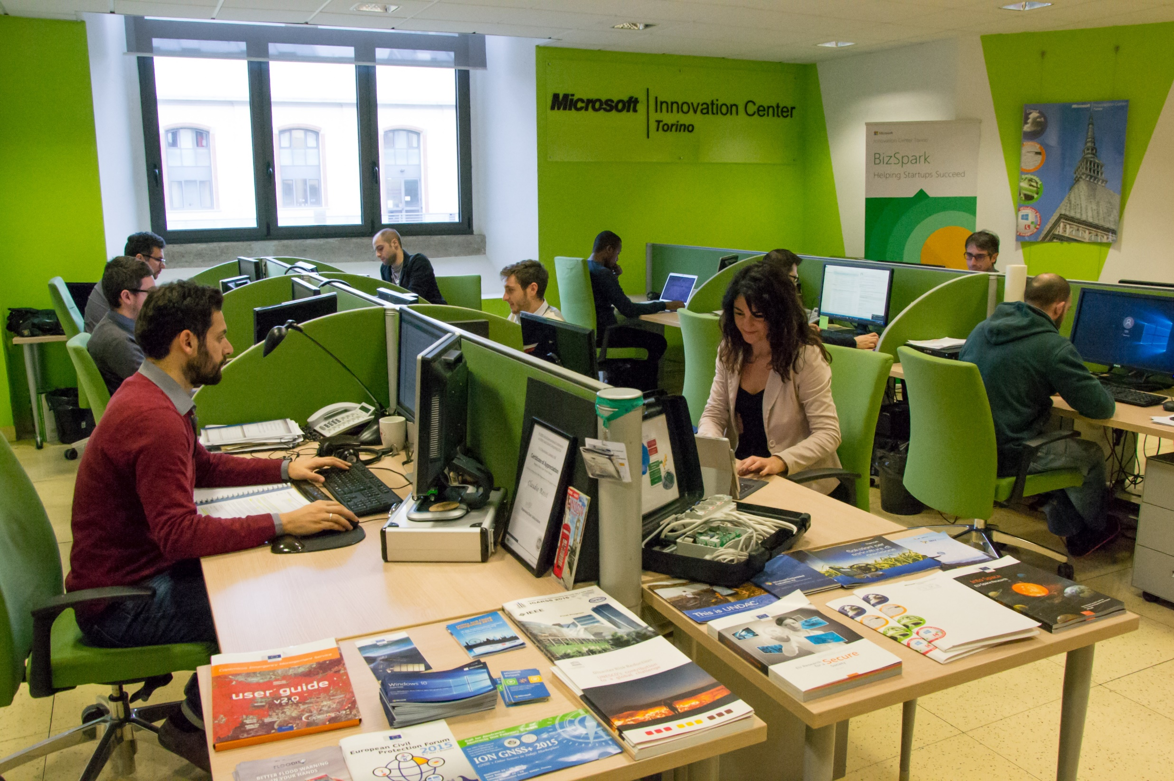
We’re working on the domain of mobile solutions and the emerging paradigms of Big Data.
We aim to support the innovation of services, products and processes realizing end-to-end solutions, based on Cloud Computing technology and connected with Smart Device applications (i.e. Embedded) following the IoT paradigm.
The smart data management support the development of the added value services.

Slide 8
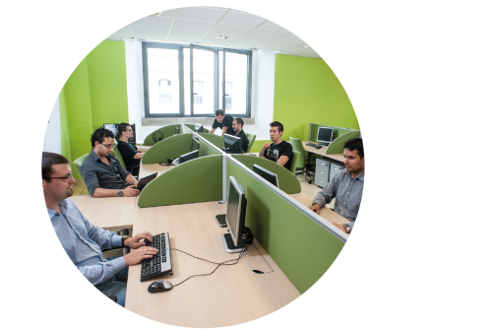
OUR TOPICS
INTERNET OF THINGS
Earth Observation
User Research
LBS
Augmented Reality
SMART PROGRAMS
Smart City and Mobility
Smart Health
Smart Energy
ITS
User Experience
INTERNET OF DATA
Mobile sensing
CLOUD
Service Design
EMERGENCY MANAGEMENT
Wearable
ENVIRONMENT
Cultural Heritage
Territory
Gamification
PRODUCTIVE ACTIVITIES
Food and agricolture
Factory of the Future
Digital manufacturing
Resilient Services
Machine Learning
INNOVATION CULTURE
Education
Training
Events
Positioning
Big Data Analysis
Sensors
FINANCIAL
SERVICES
M2M
Social Platform
Autonomous
Systems
SPACE
HUMAN TECHNOLOGIES INTERACTION
PRIVACY & SECURITY
CONTEXT AWARENESS

Slide 9




1:1
interview with profiling
Planning, organization and execution of BizSpark Camps-webinar
Technical support
& reviews
Relationship with Network Partners
Nomination for BizSpark Plus
LinkedIn Community “BizSpark Italy”
We manage the strategic and operative activities of the BizSpark Program in Italy. In particular, we hold consulting and technical trainings focused on Microsoft Azure for the BizSpark Italian startups, as well as we support startups with dedicated architectural reviews. We also cooperate with the BizSpark Network Partners, the most important incubators and accelerators in Italy, in order to consolidate the local startups ecosystem.
#startups #cloud #bizspark
Evaluation and approval
2500+
Enrolled Startups from the begin of the program in Italy
(5 years)
1435
Italian Startups Active in the three-year program
850
Italian Startups Active who use the Microsoft Azure cloud platform
www.bizspark.com

Slide 10
Microsoft Azure

Slide 11
Microsoft Azure
Microsoft Azure
Developer + App Platform
Visual Studio Family + Azure App Service
Data + Analytics
Cortana Analytics Suite
Internet of Things
Azure IoT Suite
Cloud Infrastructure
Azure + Azure Stack + Operations Management Suite

Slide 12




















Microsoft Azure
Cloud Infrastructure
Compute
Security + Management
Networking
Hybrid Operations
Developer + App Platform
Visual Studio Family + Azure App Service
Virtual Machines
Active Directory
Express Route
Azure AD Connect Health
Containers
Multi-Factor Auth
Virtual Network
AD Privileged Identity Mgmt
Data + Analytics
Cortana Analytics Suite
Remote App
Automation
Load Balancer
Backup
Batch
Key Vault
DNS
Operational Insights
Internet of Things
Azure IoT Suite
Storage
Traffic Manager
Import/Export
Blob Storage
Azure Files
Premium Storage
VPN Gateway
StorSimple
Cloud Infrastructure
Azure + Azure Stack + Operations Management Suite
Application Gateway
Site Recovery

Slide 13













Microsoft Azure
Developer + App Platform
App Platform Services
Integration
Development Tools
Media & CDN
SAAS Solutions
Microsoft Dynamics
Content Delivery Network
App Service
Storage Queues
Visual Studio
Microsoft Azure
Notification Hubs
BizTalk Services
Visual Studio Online
Media Services
Enterprise Mobility
Microsoft Enterprise Mobility Suite
Developer + App Platform
Visual Studio Family + Azure App Service
API Management
Hybrid Connections
Application Insights
Cortana Analytics Suite
Data + Analytics
Service Fabric
Service Bus
Azure SDK
Cloud Services
Internet of Things
Azure IoT Suite
Cloud Infrastructure
Azure + Azure Stack + Operations Management Suite

Slide 14










Microsoft Azure
SAAS Solutions
Microsoft Dynamics
Data + Analytics
Data
Analytics
Enterprise Mobility
Microsoft Enterprise Mobility Suite
SQL Database
SQL Data Warehouse
HDInsight
Data Factory
DocumentDB
Data Lake
Machine Learning
Mobile Engagement
Developer + App Platform
Visual Studio Family + Azure App Service
Redis Cache
Tables
Search
Data + Analytics
Cortana Analytics Suite
Internet of Things
Azure IoT Suite
Cloud Infrastructure
Azure + Azure Stack + Operations Management Suite

Slide 15

Microsoft Azure
SAAS Solutions
Microsoft Dynamics
Enterprise Mobility
Microsoft Enterprise Mobility Suite
Developer + App Platform
Visual Studio Family + Azure App Service
Internet of Things
IoT Hub
Stream Analytics
Logic Apps
Data + Analytics
Cortana Analytics Suite
Internet of Things
Azure IoT Suite
Cloud Infrastructure
Azure + Azure Stack + Operations Management Suite

